Slide 1
Memory Management
Ashish Sangwan
Dipankar Sarkar
Ghanshyam Dass
Naman Singhal

Slide 2
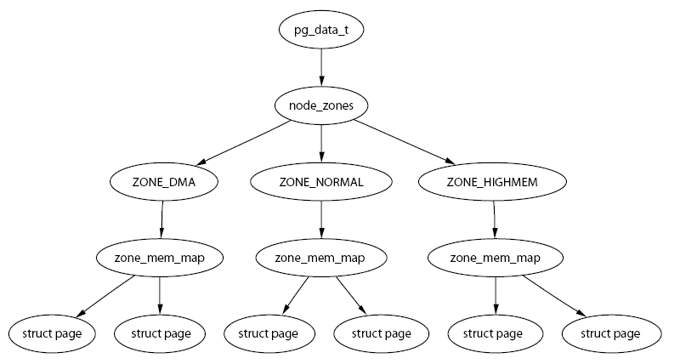
Describing Physical Memory

Slide 3
Nodes
typedef struct pglist_data {
zone_t node_zones[MAX_NR_ZONES];
zonelist_t node_zonelists[GFP_ZONEMASK+1];
int nr_zones;
struct page *node_mem_map;
unsigned long *valid_addr_bitmap;
struct bootmem_data *bdata;
unsigned long node_start_paddr;
unsigned long node_start_mapnr;
unsigned long node_size;
int node_id;
struct pglist_data *node_next;
} pg_data_t;

Slide 4
Zones
typedef struct zone_struct {
spinlock_t lock;
unsigned long free_pages;
unsigned long pages_min, pages_low, pages_high;
int need_balance;
free_area_t free_area[MAX_ORDER];
wait_queue_head_t * wait_table;
unsigned long wait_table_size;
unsigned long wait_table_shift;
struct pglist_data *zone_pgdat;
struct page *zone_mem_map;
unsigned long zone_start_paddr;
unsigned long zone_start_mapnr;
char *name;
unsigned long size;
} zone_t;

Slide 5
Zone Watermarks
Pages Low: When the pages low number of free pages is reached, kswapd is woken up by the buddy allocator to start freeing pages. The value is twice the value of pages min by default.
Pages Min: When pages min is reached, the allocator will do the kswapd work in a synchronous fashion, sometimes referred to as the direct-reclaim path.
Pages High After kswapd has been woken to start freeing pages, it will not consider the zone to be “balanced” when pages high pages are free. After the watermark has been reached, kswapd will go back to sleep. The default for pages high is three times the value of pages min.

Slide 6
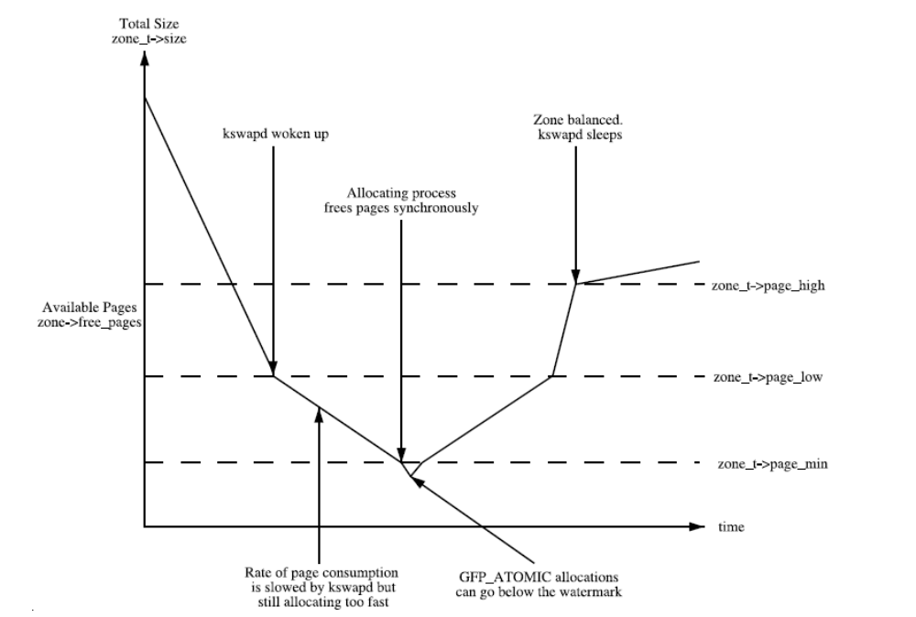
Zone Watermarks

Slide 7
Zone Wait Queue Table
When I/O is being performed on a page, such as during page-in or page-out, the I/O is locked to prevent accessing it with inconsistent data.
Processes that want to use it have to join a wait queue before the I/O can be accessed by calling wait on page().
When the I/O is completed, the page will be unlocked with UnlockPage(), and any process waiting on the queue will be woken up.
It is possible to have just one wait queue in the zone, but that would
mean that all processes waiting on any page in a zone would be woken
up when one was unlocked. This would cause a serious thundering
herd problem. Instead, a hash table of wait queues is stored in
zone_t→wait_table. In the event of a hash collision, processes may still
be woken unnecessarily, but collisions are not expected to occur
frequently.

Slide 8
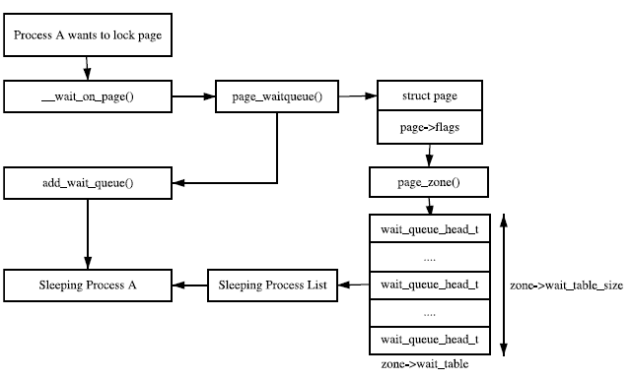
Sleeping on a locked Page

Slide 9
Struct page
typedef struct page {
struct list_head list;
struct address_space *mapping;
unsigned long index;
struct page *next_hash;
atomic_t count;
unsigned long flags;
struct list_head lru;
struct page **pprev_hash;
struct buffer_head * buffers;
#if defined(CONFIG_HIGHMEM) || defined(WANT_PAGE_VIRTUAL)
void *virtual;
#endif /* CONFIG_HIGMEM || WANT_PAGE_VIRTUAL */
} mem_map_t;

Slide 10
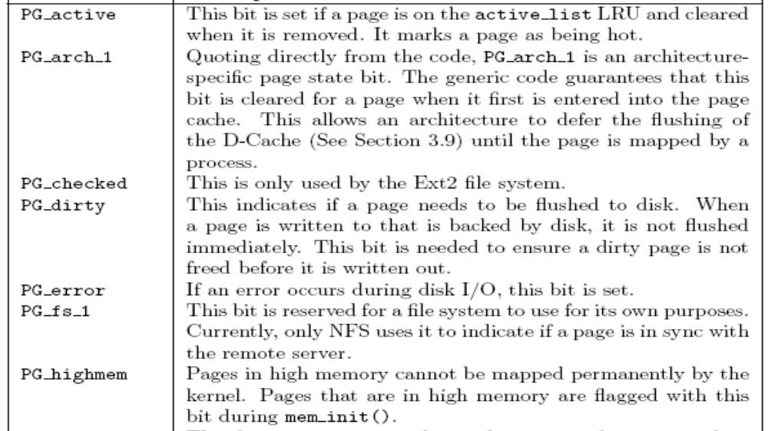
Page Status Flag

Slide 11
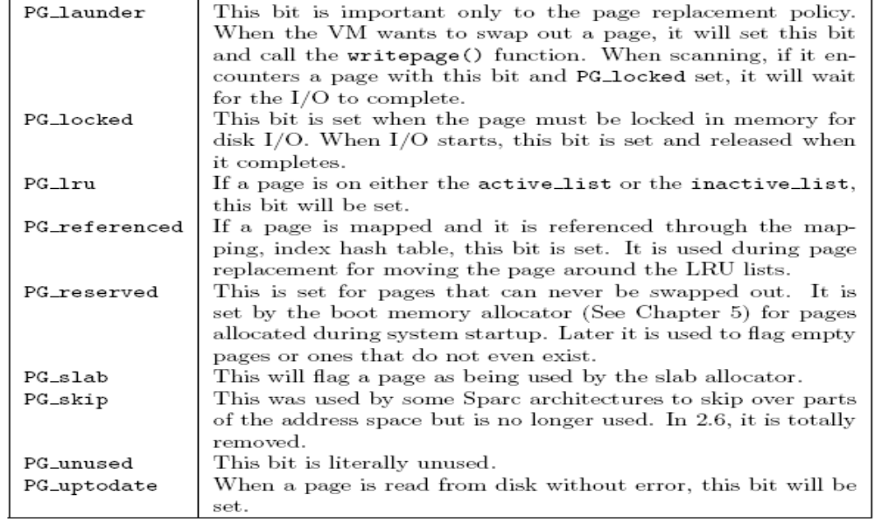
Page Status Flag(Contd.)

Slide 12
Page Table Management
Linux instead maintains the concept of a three-level page table in the architecture independent code even if the underlying architecture does not support it.
Architectures that manage their Memory Management Unit (MMU) differently are expected to emulate the three-level page tables.

Slide 13
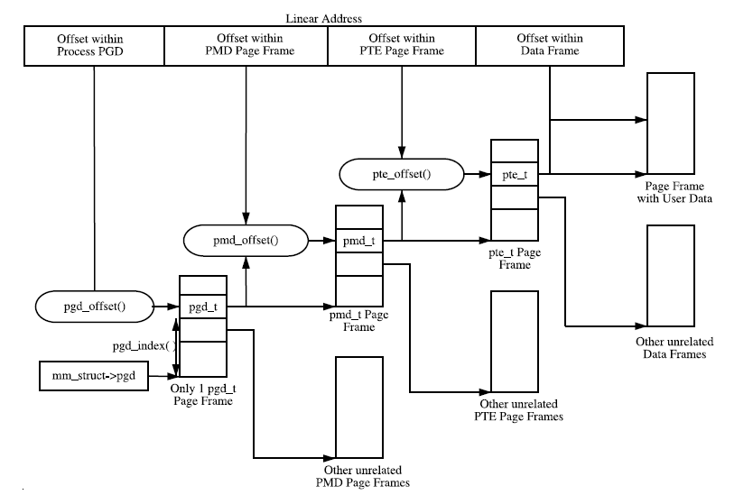
Page Table Layout

Slide 14
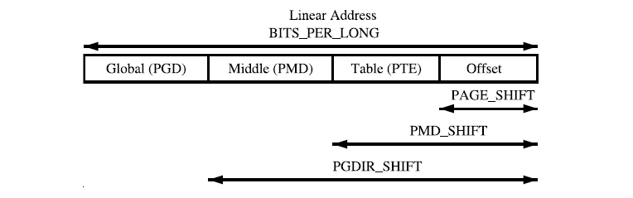
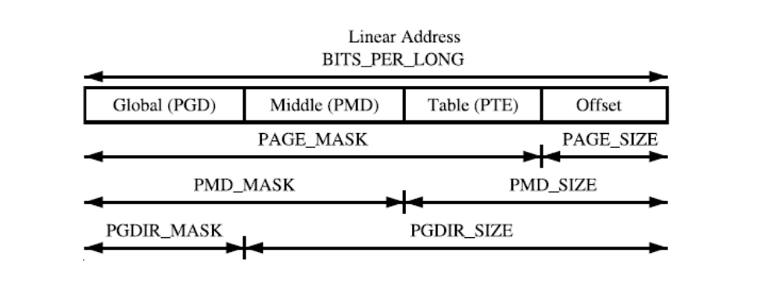
Linear Address Size Macros

Slide 15
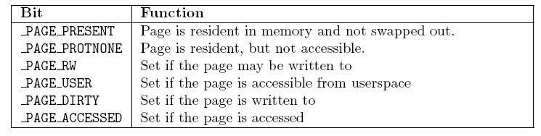
Page Table Protection Bit

Slide 16
PTE API
The read permissions for an entry are tested with pte_read(), set with pte_mkread() and cleared with pte_rdprotect().
The write permissions are tested with pte_write(), set with pte_mkwrite() and cleared with pte_wrprotect().
The execute permissions are tested with pte_exec(), set with pte_mkexec() and cleared with pte_exprotect().
The dirty bit can be checked by pte_dirty(), set by pte_mkdirty(), cleared with pte_mkclean().
The accessed bit can be checked by pte_young(), set by pte_mkyoung(), cleared with pte_old().

Slide 17
Allocating and Freeing Page Tables
Page tables, as stated, are physical pages containing an array of entries, and the allocation and freeing of physical pages is a relatively expensive operation, both in terms of time and the fact that interrupts are disabled during page allocation. The allocation and deletion of page tables, at any of the three levels, is a very frequent operation, so it is important the operation is as quick as possible.
Hence the pages used for the page tables are cached in a number of different lists called quicklists.
pgd_quicklist, pmd_quicklist and pte_quicklist.

Slide 18
Mapping Addresses to a struct page
There is a requirement for Linux to have a fast method of mapping virtual addresses to physical addresses and for mapping struct pages to their physical address.
Linux achieves this by knowing where, in both virtual and physical memory, the global mem map array is because the global array has pointers to all struct pages representing physical memory in the system.
Physical addresses are translated to struct pages by treating them as an index into the mem map array.
#define __pa(x) ((unsigned long)(x)-PAGE_OFFSET)
#define virt_to_page(kaddr) (mem_map + (__pa(kaddr) >> PAGE_SHIFT))

Slide 19
Reverse Mapping
Reverse mapping(rmap) grants the ability to locate all PTEs that map a particular page given just the struct page. In 2.4, the only way to find all PTEs that mapped a shared page, such as a memory mapped shared library, is to linearly search all page tables belonging to all processes.
This is far too expensive, and Linux tries to avoid the problem by using the swap cache . This means that, with many shared pages, Linux may have to swap out entire processes regardless of the page age and usage patterns.
In 2.6 instead has a PTE chain associated with every struct page, which may be traversed to remove a page from all page tables that reference it. This way, pages in the LRU can be swapped out in an intelligent manner without resorting to swapping entire processes.)

Slide 20
rmap - working
First, it is the responsibility of the slab allocator to allocate and manage struct pte chains because it is this type of task that the slab allocator is best at.
Each struct pte chain can hold up to NRPTE pointers to PTE structures. After that many PTEs have been filled, a struct pte chain is allocated and added to the chain.
The struct pte chain has two fields. The first is unsigned long next and idx, which has two purposes. When next and idx is ANDed with NRPTE, it returns the number of PTEs currently in this struct pte chain and indicates where the next free slot is. When next and idx is ANDed with the negation of NRPTE (i.e., ∼NRPTE), a pointer to the next struct pte chain in the chain is returned2.

Slide 21
rmap – working - (Contd.)
what happens when a new PTE needs to map a page?
The basic process is to have the caller allocate a new pte chain with pte chain alloc(). This allocated chain is passed with the struct page and the PTE to page add rmap(). If the existing PTE chain associated with the page has slots available, it will be used, and the pte chain allocated by the caller is returned. If no slots were available, the allocated pte chain will be added to the chain, and NULL returned.

Slide 22
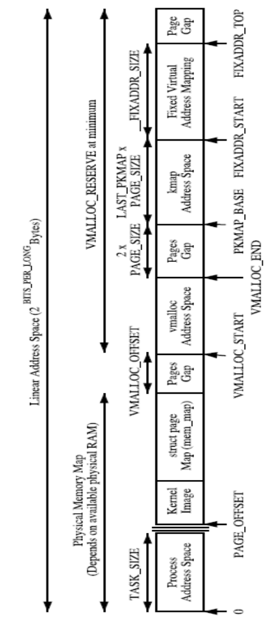
Kernel Address Space
The region between PAGE OFFSET and VMALLOC START - VMALLOC OFFSET is the physical memory map, and the size of the region depends on the amount of available RAM.

Slide 23
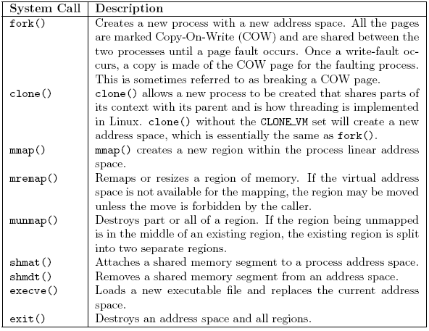
System Calls Related to Memory Regions

Slide 24
Process Address Space Descriptor
struct mm_struct {
struct vm_area_struct * mmap;
rb_root_t mm_rb;
struct vm_area_struct * mmap_cache;
pgd_t * pgd;
atomic_t mm_users;
atomic_t mm_count;
int map_count;
struct rw_semaphore mmap_sem;
spinlock_t page_table_lock;
struct list_head mmlist;
unsigned long start_code, end_code, start_data, end_data;
unsigned long start_brk, brk, start_stack;
unsigned long arg_start, arg_end, env_start, env_end;
unsigned long rss, total_vm, locked_vm;
unsigned long def_flags;
unsigned long cpu_vm_mask;
unsigned long swap_address;
unsigned dumpable:1;
/* Architecture-specific MM context */
mm_context_t context;
};

Slide 25
Descriptor API
Allocating a Descriptor: Allocate mm() is just a preprocessor macro that allocates an mm struct from the slab allocator. mm alloc() allocates from slab and then calls mm init() to initialize it.
Initializing a Descriptor: The first mm_struct in the system that is initialized by the macro INIT_MM() is called init_mm. All subsequent mm_structs are copies of a parent mm_struct.
Destroying a Descriptor: The mm_count count is decremented with mmdrop() because all the users of the page tables and VMAs are counted as one mm_struct user. When mm_count reaches zero, the mm_struct will be destroyed.

Slide 26
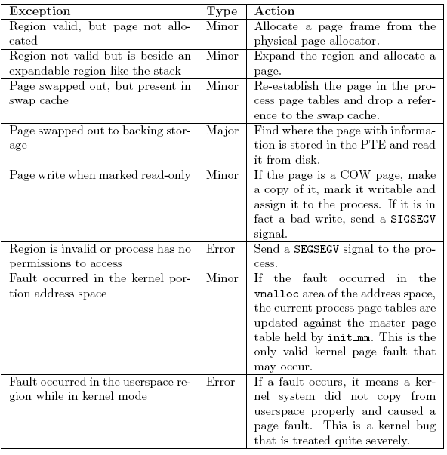
Reasons for Page-Fault

Slide 27
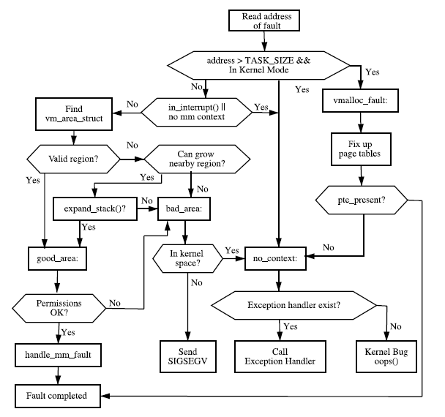
Page Fault Flow Diagram

Slide 28
Handling Page Fault
The first stage of the decision is to check if the PTE is marked not present or if it has been allocated with, which is checked by pte_present() and pte_none(). If no PTE has been allocated (pte_none() returned true), do_no_page() is called, which handles Demand Allocation. Otherwise, it is a page that has been swapped out to disk and do_swap_page() performs Demand Paging.
A COW (Copy-On-Write) page is one that is shared between multiple processes(usually a parent and child) until a write occurs, after which a private copy is made for the writing process. A COW page is recognized because the VMA for the region is marked writable even though the individual PTE is not. If it is not a COW page, the page is simply marked dirty because it has been written to.

Slide 29
Managing Free Blocks
The 0th element of the array will point to a list of free page blocks of size 2⁰ or 1 page, the 1st element will be a list of 2¹ or 2 pages up to 2^{MAX_ORDER – 1} number of pages. This eliminates the chance that a larger block will be split to satisfy a request where a smaller block would have sufficed. The page blocks are maintained on a linear linked list using page→list.
Each zone has a free_area_t struct array called free_area[MAX_ORDER]. It is declared in <linux/mm.h> as follows:
22 typedef struct free_area_struct {
23 struct list_head free_list;
24 unsigned long *map;
25 } free_area_t;

Slide 30
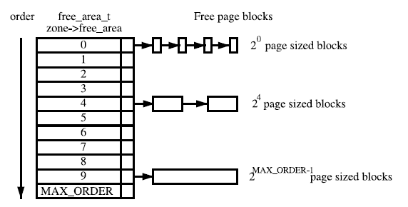
Free Page Block Management
This Page describes how physical pages are managed and allocated in Linux.
The principal algorithm used is the Binary Buddy Allocator. If a block of the desired size is not available, a large block is broken up in half, and the two blocks are buddies to each other. One half is used for the allocation, and the other is free. The blocks are continuously halved as necessary until a block of the desired size is available. When a block is later freed, the buddy is examined, and the two are coalesced if it is free.

Slide 31
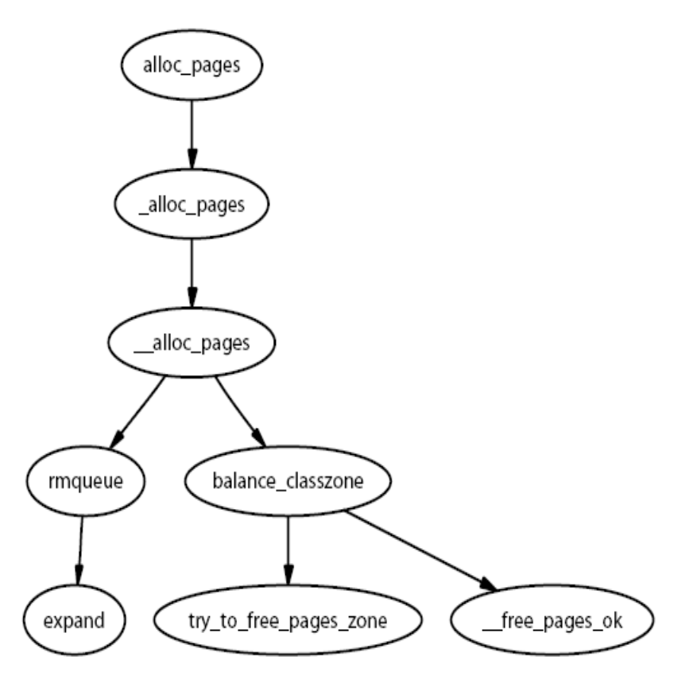
Allocating Physical Pages
All of functions of the API take a gfp_mask as a parameter, which is a set of flags that determine how the allocator will behave.
These flags determine how the allocator and kswapd will behave for the allocation and freeing of pages.
For example, an interrupt handler may not sleep, so it will not have the GFP_WAIT flag set because this flag indicates the caller may sleep.
There are three sets of GFP flags, which are all defined in <linux/mm.h>.

Slide 32
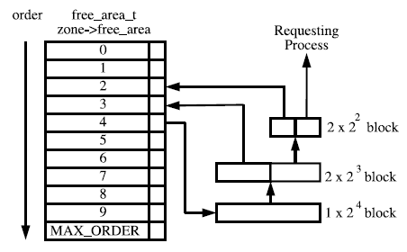
Allocating Physical Pages –
An Example

Slide 33
Allocating Physical Pages
Allocation is done based on the buddy system discussed earlier.
Which memory node or pg_data_t to use ?
  Linux uses a node-local allocation policy, which aims to use the memory bank associated with the CPU running the page-allocating process. Here, the function alloc pages() is what is important because this function is different depending on whether the kernel is built for a UMA (function in mm/page alloc.c) or NUMA (function in mm/numa.c) machine.
__alloc_pages(), which is never called directly, examines the selected zone and checks if it is suitable to allocate from based on the number of available pages. If the zone is not suitable, the allocator may fall back to other zones. The order of zones to fall back on is decided at boot time by the function build_zonelists(). If number of free pages reaches the pages low watermark, it will wake kswapd to begin freeing up pages from zones, and, if memory is extremely tight, the caller will do the work of kswapd itself.
After the zone has finally been decided on, the function rmqueue() is called to allocate the block of pages or split higher level blocks if one of the appropriate size is not available.

Slide 34
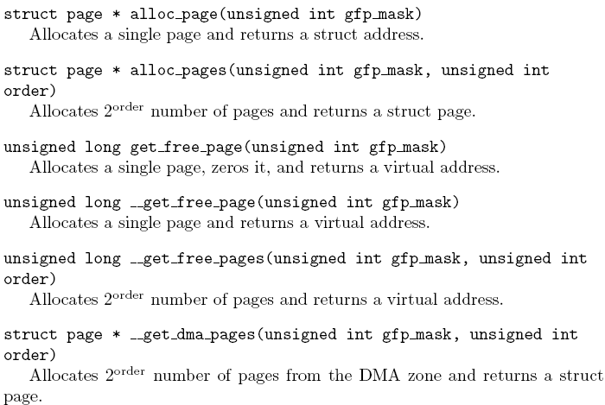
Physical Page Allocation API

Slide 35
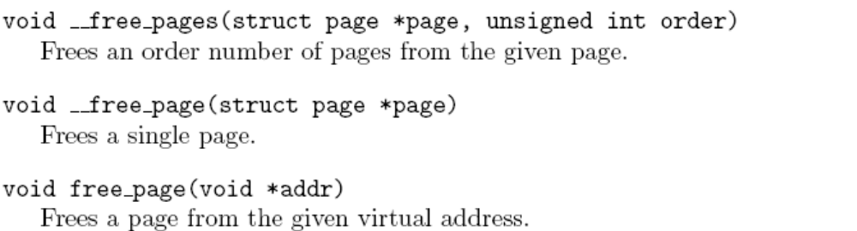
Free Pages
The principal function for freeing pages is __free_pages_ok(), and it should not be called directly. Instead the function __free_ pages() is provided, which performs simple checks
When a buddy is freed, Linux tries to coalesce the buddies together immediately if possible. This is not optimal because the worst-case scenario will have many coalitions followed by the immediate splitting of the same blocks.

Slide 36
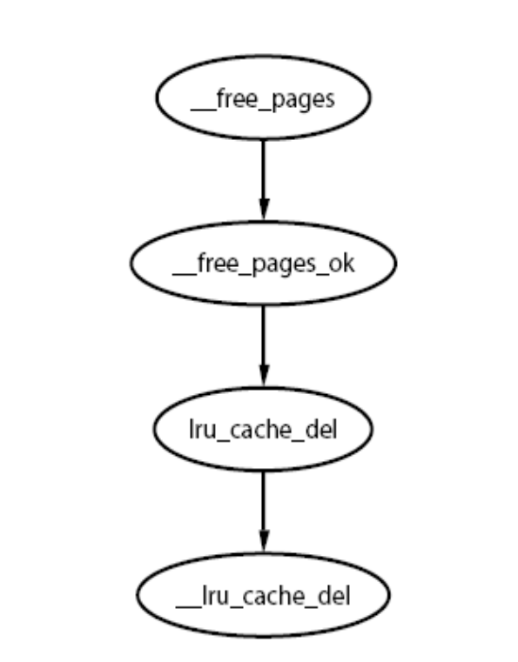
Free Pages
To detect if the buddies can be merged, Linux checks the bit corresponding to the affected pair of buddies in free_area→map. Because one buddy has just been freed by this function, it is obviously known that at least one buddy is free. If the bit in the map is 0 after toggling, we know that the other buddy must also be free because, if the bit is 0, it means both buddies are either both free or both allocated. If both are free, they may be merged.

Slide 37
Slab Allocator
The basic idea behind the slab allocator is to have caches of commonly used objects kept in an initialized state available for use by the kernel. Without an object-based allocator, the kernel will spend much of its time allocating, initializing and freeing the same object.
The slab allocator consists of a variable number of caches that are linked together on a doubly linked circular list called a cache chain.
The slab allocator has three principle aims:
The allocation of small blocks of memory to help eliminate internal fragmentation that would be otherwise caused by the buddy system.
The caching of commonly used objects so that the system does not waste time allocating, initializing and destroying objects.
Better use of the hardware cache by aligning objects to the L1 or L2 caches.

Slide 38
Page Frame Reclamation
A running system will eventually use all available page frames for purposes like disk buffers, dentries, inode entries, process pages and so on. Linux needs to select old pages that can be freed and invalidated for new uses before physical memory is exhausted.

Slide 39
Page Replacement Policy
The LRU in Linux consists of two lists called the active list and the inactive list. The objective is for the active list to contain the working set of all processes and the inactive list to contain reclaim candidates.
The replacement policy is a global one. When pages reach the bottom of the list, the referenced flag is checked. If it is set, it is moved back to the top of the list, and the next page is checked. If it is cleared, it is moved to the inactive list.
The algorithm describes how the size of the two lists have to be tuned, but Linux takes a simpler approach by using refill inactive() to move pages from the bottom of active list to inactive list to keep active list about two-thirds the size of the total page cache.
In summary, the algorithm does exhibit LRU-like behavior, and it has been shown by benchmarks to perform well in practice.

Slide 40
Pageout Daemon (kswapd)
During system startup, a kernel thread called kswapd is started from kswapd init(), which continuously executes the function kswapd() in mm/vmscan.c, which usually sleeps.
The casual reader may think that, with a sufficient amount of memory, swap is unnecessary. A significant number of the pages referenced by a process early in its life may only be used for initialization and then never used again. It is better to swap out those pages and create more disk buffers than leave them resident and unused.

Slide 41
MM Comparison – Solaris
In Solaris, every process has an "address space" made up of logical section divisions called "segments."
The segments of a process address space are viewable via pmap(1). Solaris divides the memory management code and data structures into platform-independent and platform-specific parts.
The platform-specific portions of memory management is in the HAT, or hardware address translation, layer.

Slide 42
MM Comparison - FreeBSD
FreeBSD describes its process address space by a vmspace, divided into logical sections called regions.
Hardware-dependent portions are in the "pmap" (physical map) module and "vmap" routines handle hardware-independent portions and data structures.
Linux uses a memory descriptor to divides the process address space into logical sections called "memory areas" to describe process address space.

Slide 43
MM Comparison contd...
Linux divides machine-dependent layers from machine-independent layers at a much higher level in the software.
On Solaris and FreeBSD, much of the code dealing with, for instance, page fault handling is machine-independent. On Linux, the code to handle page faults is pretty much machine-dependent from the beginning of the fault handling. A consequence of this is that Linux can handle much of the paging code more quickly because there is less data abstraction (layering) in the code.
However, the cost is that a change in the underlying hardware or model requires more changes to the code. Solaris and FreeBSD isolate such changes to the HAT and pmap layers respectively.

Slide 44
Solaris Paging
Solaris uses a free list, hashed list, and vnode page list to maintain its variation of an LRU replacement algorithm. Instead of scanning the vnode or hash page lists (more or less the equivalent of the "active"/"hot" lists in the FreeBSD/Linux implementations), Solaris scans all pages uses a "two-handed clock" algorithm as described in Solaris Internals and elsewhere. The two hands stay a fixed distance apart. The front hand ages the page by clearing reference bit(s) for the page. If no process has referenced the page since the front hand visited the page, the back hand will free the page (first asynchronously writing the page to disk if it is modified).

Slide 45
FreeBSD Paging
All three operating systems use a variation of a least recently used algorithm for page stealing/replacement. All three have a daemon process/thread to do page replacement. On FreeBSD, the vm_pageout daemon wakes up periodically and when free memory becomes low. When available memory goes below some thresholds, vm_pageout runs a routine (vm_pageout_scan) to scan memory to try to free some pages. The vm_pageout_scan routine may need to write modified pages asynchronously to disk before freeing them. There is one of these daemons regardless of number of CPUs. The FreeBSD daemon uses values that, for the most part, are hard-coded or tunable in order to determine paging thresholds.

Slide 46
Comparison - conclusion
A brief example to highlight differences is page fault handling. In Solaris, when a page fault occurs, the code starts in a platform-specific trap handler, then calls a generic as_fault() routine. This routine determines the segment where the fault occurred and calls a "segment driver" to handle the fault. The segment driver calls into file system code. The file system code calls into the device driver to bring in the page. When the page-in is complete, the segment driver calls the HAT layer to update page table entries (or their equivalent). On Linux, when a page fault occurs, the kernel calls the code to handle the fault. You are immediately into platform-specific code. This means the fault handling code can be quicker in Linux, but the Linux code may not be as easily extensible or ported.

Slide 47
Bibliography
Perens publication – Understanding the linux virtual memory manager (Available online)
http://www.opensolaris.org/os/article/2005-10-14_a_comparison_of_solaris__linux__ and_freebsd_kernels/ - comparing various unix kernels.
Last but not the least – Silberschatz, Galvin “OS made easy for dinosaurs” :)

